Slide 1
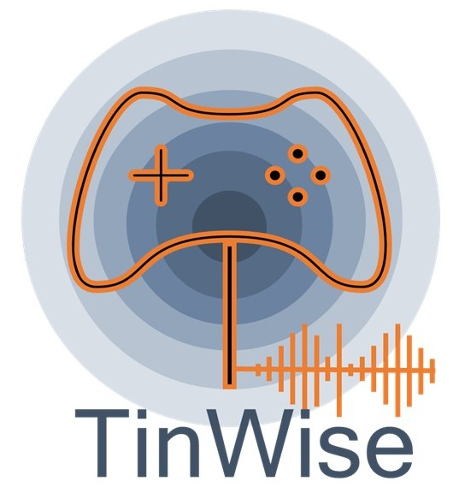
TinWise
WP1 – Need analysis
Tinnitus Center, Charité – Universitaetsmedizin Berlin

Slide 2
Contents
TinWise: WP1 – Need Analysis
WP1 – Need Analysis: Survey
WP1 – Need Analysis: Results
TinWise: Outlook

Slide 3
TinWise:
WP1 – Need Analysis
1
TinWise: WP1 – Need Analysis

Slide 4

TinWise: WP1 – Need Analysis
Objectives
WP1 aims to understand the needs and knowledge gaps of people affected by tinnitus as a foundation for designing the TinWise digital learning platform with gamified health literacy tools.
Assessment of user needs („Needs analysis“):
Conduct quantitative survey to reveal gaps in health literacy and self-help resources of tinnitus sufferers.
Inform platform design:
Gather data that will directly guide the content, features and user experience of the TinWise online platform, ensuring relevance and usability for end-users.
TinWise: WP1 – Need Analysis

Slide 5



TinWise: WP1 – Need Analysis
Hypotheses
Tinnitus-specific health literacy in individuals with tinnitus is associated with tinnitus-related distress, health-related quality of life, general health literacy, and the extent of self-help utilization
1
Individuals with higher levels of health literacy demonstrate better health-related quality of life, more active self-help utilization, and fewer comorbidities.
2
Certain demographic groups (e.g., older patients or individuals with lower educational levels) show greater needs of health literacy support.
3
TinWise: WP1 – Need Analysis

Slide 6
WP1 – Need Analysis:
Survey
2
TinWise: WP1 – Need Analysis

Slide 7
WP1 – Need Analysis: Survey
Questionnaires
Demographics
Country
Gender
Age
Insurance
Relationship status
Occupational status
1
Tinnitus
Laterality
Date of Onset
Origin
Loudness
Treatments
Specialists
Hyperacusis
Hearing
Comorbidities
Self-Help
Membership
Satisfaction
Doubts
2
3
Health Literacy
General (long and short version)
Tinnitus-specific (long and short version)
4
5
Quality of Life
Depression
Stress
Worries
TinWise: WP1 – Need Analysis

Slide 8
WP1 – Need Analysis: Survey
Participants
244
Started the survey
244
194
Completed the survey
Fullfilled inclusion criteria (age > 18 & tinnitus)
186
TinWise: WP1 – Need Analysis

Slide 9
WP1 – Need Analysis:
Results
3
TinWise: WP1 – Need Analysis

Slide 10
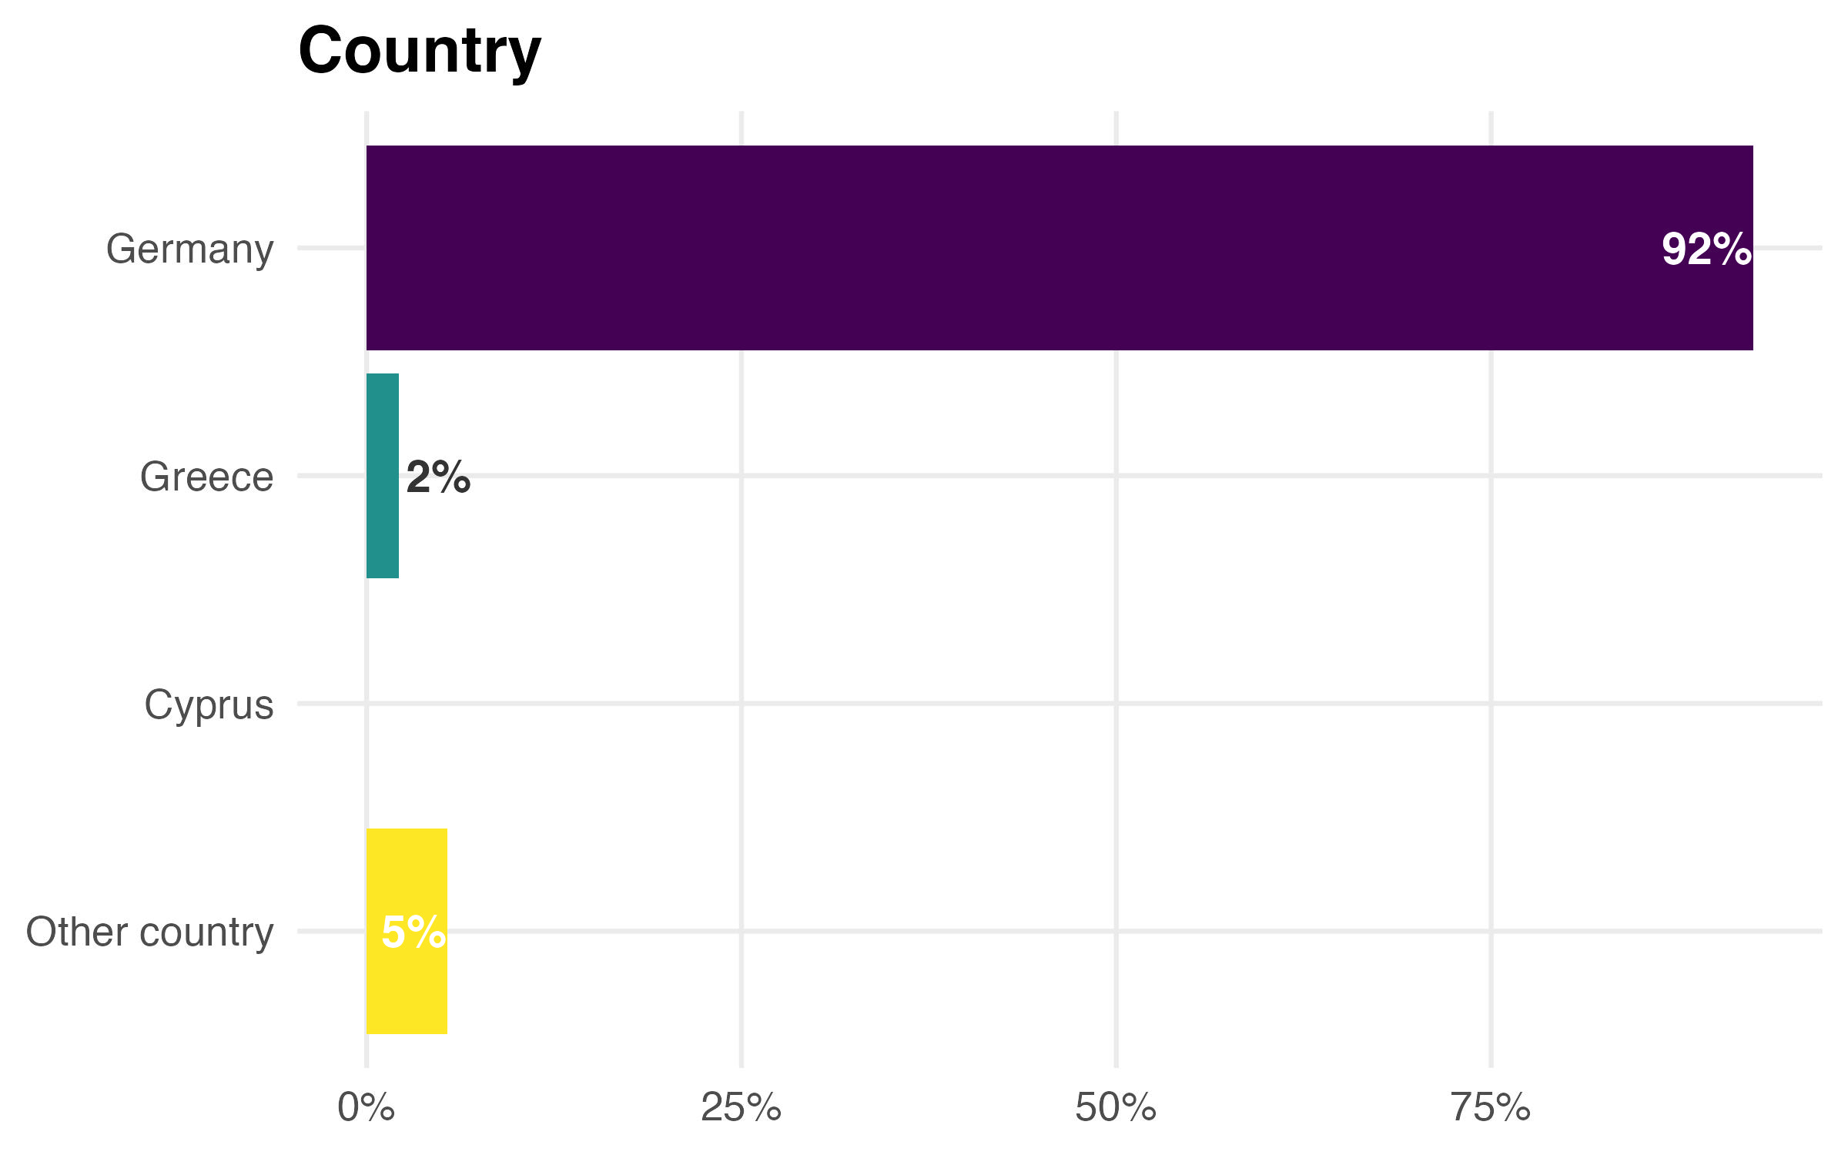
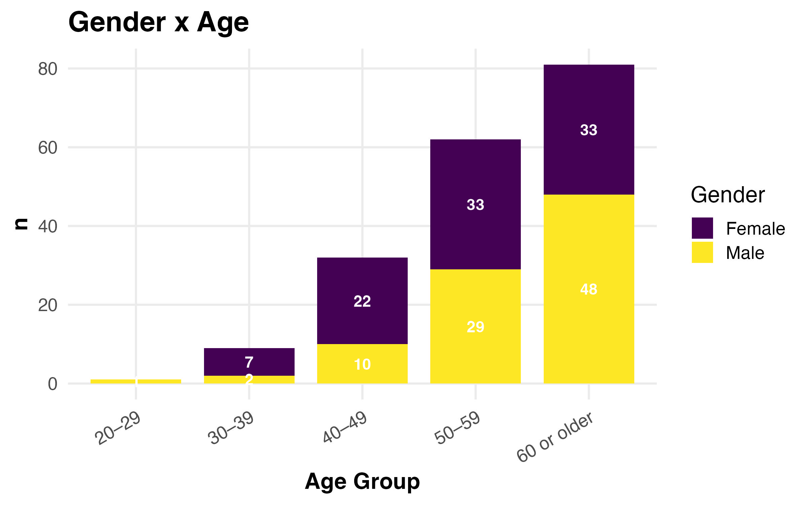
WP1 – Need Analysis: Results
Demographics
TinWise: WP1 – Need Analysis

Slide 11
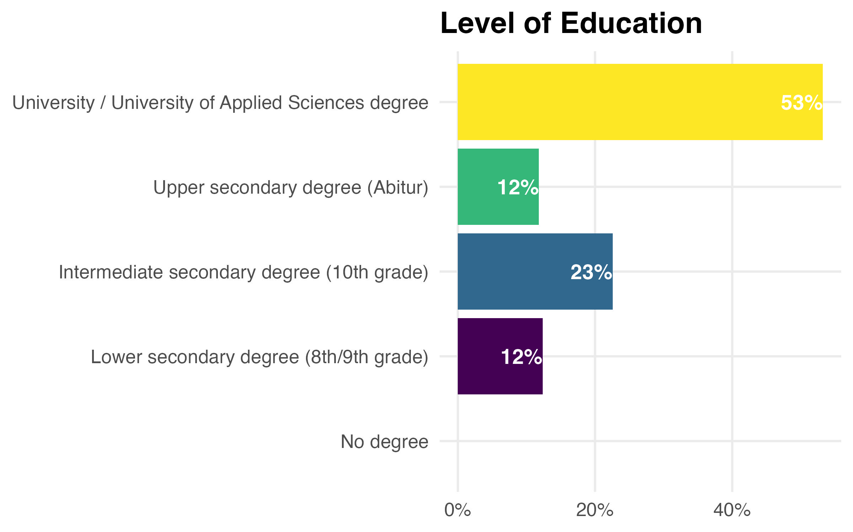
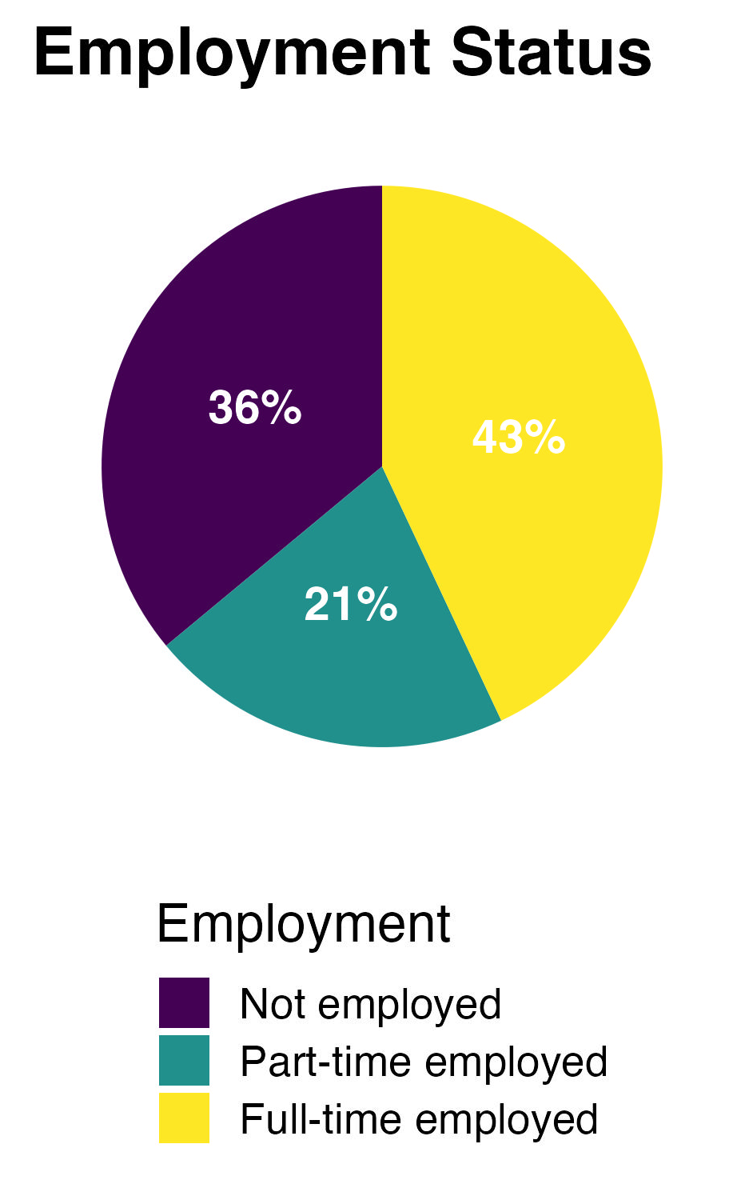
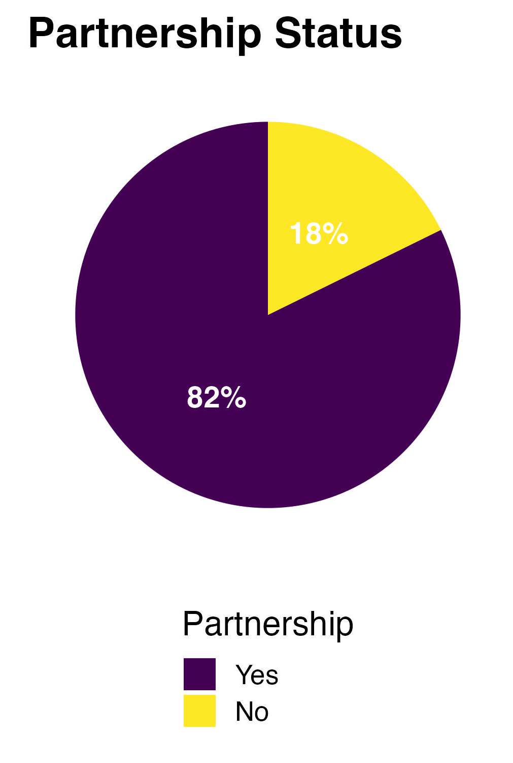
WP1 – Need Analysis: Results
Demographics
TinWise: WP1 – Need Analysis

Slide 12
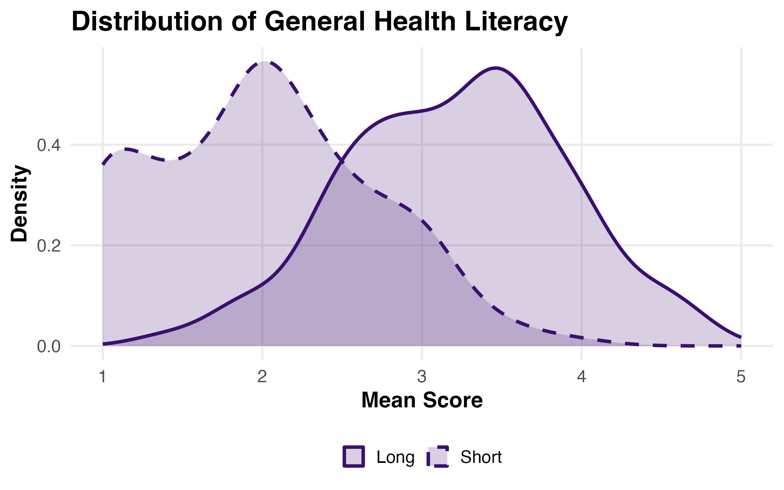
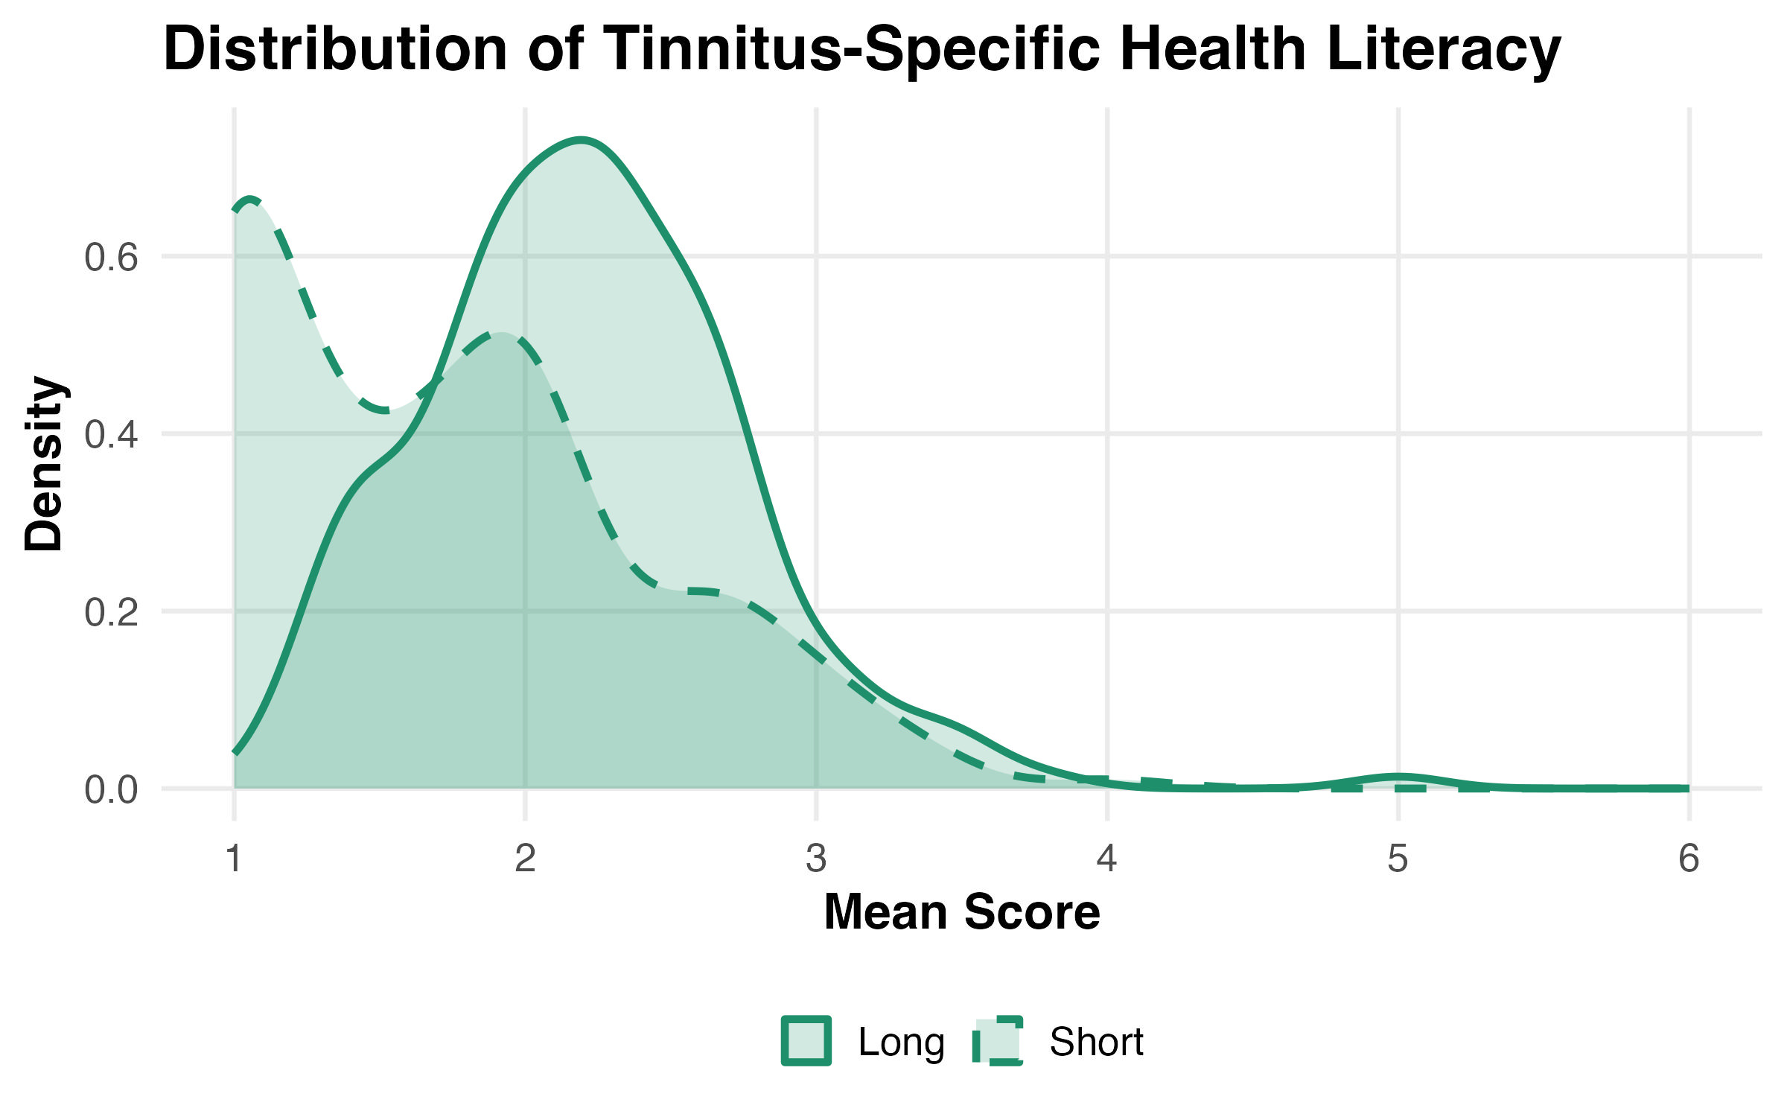
WP1 – Need Analysis: Results
Health Literacy
TinWise: WP1 – Need Analysis

Slide 13
WP1 – Need Analysis: Results
Demographics
Variable | Category | Count | Percentage
Country | Germany | 172 | 92.5
 | Greece | 4 | 2.2
 | Other country | 10 | 5.4
Gender | Female | 95 | 51.1
 | Male | 90 | 48.4
 | Diverse | 1 | 0.5
Age | 20–29 | 1 | 0.5
 | 30–39 | 10 | 5.4
 | 40–49 | 32 | 17.2
 | 50–59 | 62 | 33.3
 | 60 or older | 81 | 43.5
Partnership status | Yes | 153 | 82.3
 | No | 33 | 17.7
Education | Lower secondary degree (8th/9th grade) | 23 | 12.4
 | Intermediate secondary degree (10th grade) | 42 | 22.6
 | Upper secondary degree (Abitur) | 22 | 11.8
 | University / University of Applied Sciences degree | 99 | 53.2
Employment status | Not employed | 67 | 36.0
 | Part-time employed | 39 | 21.0
 | Full-time employed | 80 | 43.0
Health insurance | Statutory health insurance | 134 | 72.0
 | Statutory with supplementary insurance | 25 | 13.4
 | Private health insurance | 12 | 6.5
 | Civil servant aid scheme | 13 | 7.0
 | Other insurance | 2 | 1.1
SH membership | Yes | 68 | 36.6
 | No | 118 | 63.4
Tinnitus laterality | Right | 31 | 16.7
 | Left | 21 | 11.3
 | Bilateral | 134 | 72.0
Variable | Mean (SD)
Health Literacy (General) – long | 3.22 (0.69)
Health Literacy (General) – short | 1.99 (0.69)
Health Literacy (Tinnitus) – long | 1.72 (0.68)
Health Literacy (Tinnitus) – short | 2.21 (0.56)
Tinnitus Distress | 1.88 (0.58)
Tinnitus Worries | 2.14 (1.06)
Depression | 1.50 (0.59)
Stress | 2.68 (1.12)
Perceived Health | 2.74 (0.83)
Quality of Life | 3.23 (0.90)
Tinnitus Duration | 15.57 (14.08)
Tinnitus Loudness | 7.42 (2.17)
Hyperakusis | 3.44 (1.18)
Hearing | 2.38 (0.99)
Comorbidities (Number) | 4.89 (2.95)
Consulted Doctors (Number) | 3.04 (2.30)
Types of Therapies (Number) | 3.30 (2.24)
Self Help Satisfaction | 1.88 (0.82)
Self Help - Doubts | 2.67 (0.79)
TinWise: WP1 – Need Analysis

Slide 14
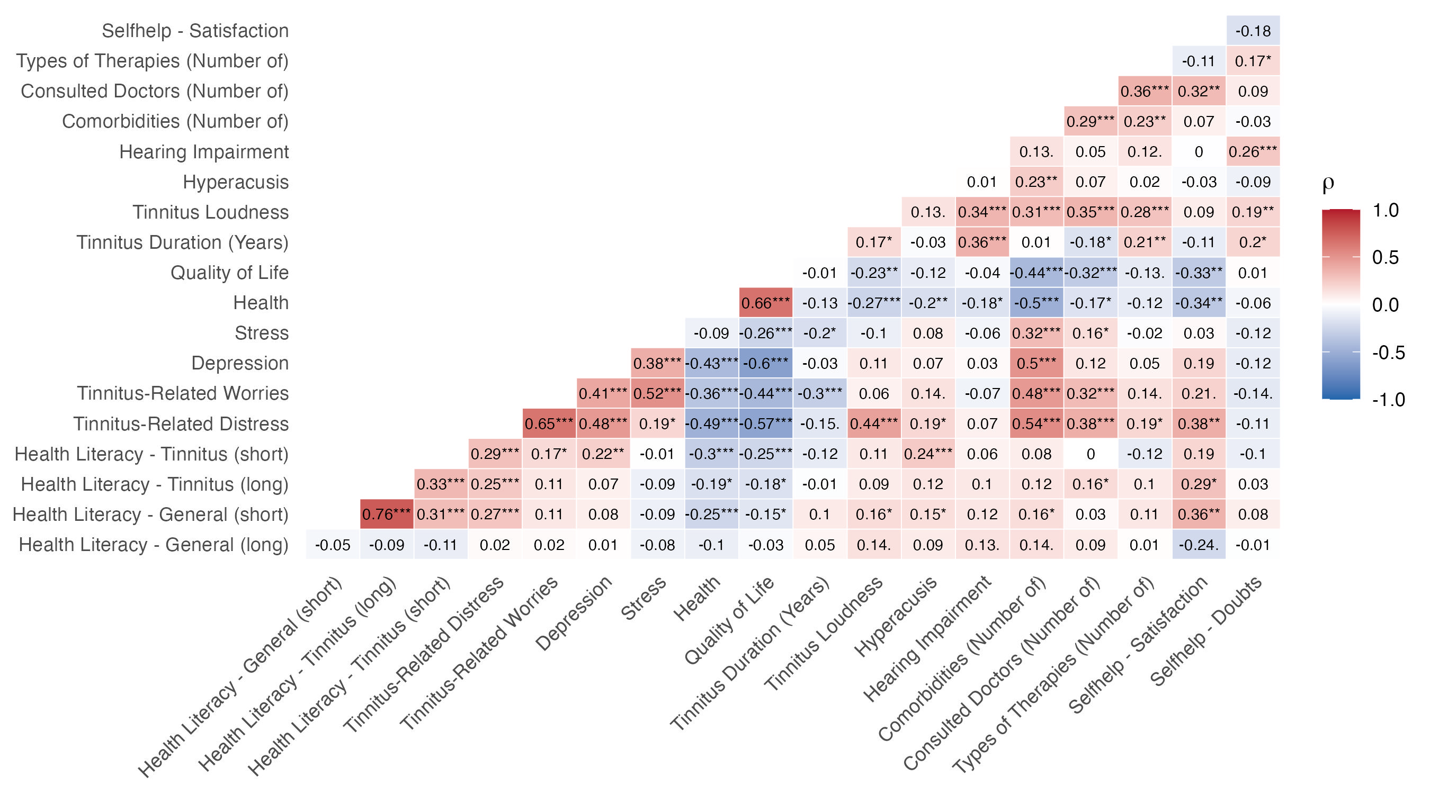
WP1 – Need Analysis: Results
Correlations
TinWise: WP1 – Need Analysis

Slide 15
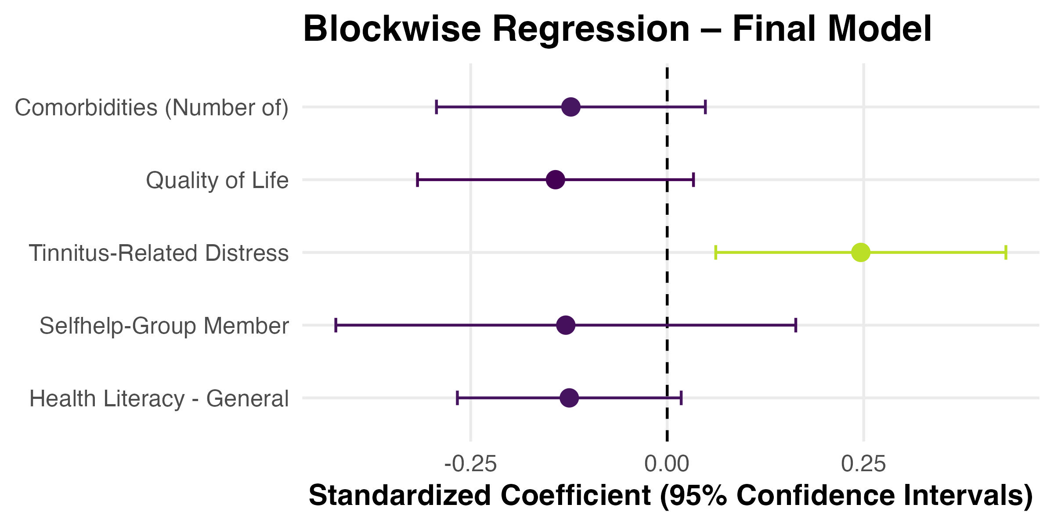
WP1 – Need Analysis: Results
Predictors of Tinnitus-Related Health Literacy (long)
TinWise: WP1 – Need Analysis

Slide 16
WP1 – Need Analysis: Results
Predictors of Tinnitus-Related Health Literacy (long)
 | Model 1 |  |  | Model 2 |  |  | Model 3
 | Beta | CI | p | Beta | CI | p | Beta | CI | p
Health Literacy (general) | -0.102 | [-0.221, 0.016] | 0.091 | -0.105 | [-0.222, 0.011] | 0.076 | -0.102 | [-0.218, 0.015] | 0.086
Self-Help Membership | -0.053 | [-0.221, 0.116] | 0.537 | -0.082 | [-0.246, 0.082] | 0.325 | -0.072 | [-0.236, 0.092] | 0.385
Tinnitus-related Distress |  |  |  | 0.302 | [0.143, 0.461] | < .001 | 0.237 | [0.059, 0.414] | 0.009
Comorbidities (Number) |  |  |  | -0.018 | [-0.049, 0.014] | 0.279 | -0.023 | [-0.056, 0.009] | 0.159
Quality of Life |  |  |  |  |  |  | -0.089 | [-0.198, 0.021] | 0.112
TinWise: WP1 – Need Analysis

Slide 17
WP1 – Need Analysis: Results
Demographic Predictors of General Health Literacy
Prädiktor | Beta | CI | p
Age: 30–39 | -0.992 | [-2.426, 0.443] | 0.174
Age: 40–49 | -1.319 | [-2.707, 0.068] | 0.062
Age: 50–59 | -1.127 | [-2.499, 0.245] | 0.107
Age: 60 or older | -1.074 | [-2.429, 0.28] | 0.119
Education: Intermediate secondary degree (10th grade) | -0.088 | [-0.438, 0.262] | 0.620
Education: Upper secondary degree | 0.163 | [-0.243, 0.569] | 0.428
Education: University / University of Applied Sciences degree | 0.157 | [-0.157, 0.47] | 0.325
Gender: Male | -0.229 | [-0.439, -0.019] | 0.033
Partnership: No | -0.072 | [-0.332, 0.189] | 0.588
Employment: Part-time employed | -0.198 | [-0.508, 0.111] | 0.208
Employment: Full-time employed | -0.244 | [-0.515, 0.027] | 0.077
Long Version
TinWise: WP1 – Need Analysis

Slide 18
WP1 – Need Analysis: Results
Demographic Predictors of General Health Literacy
Prädiktor | Beta | CI | p
Age: 30–39 | 1.153 | [-0.278, 2.584] | 0.113
Age: 40–49 | 1.100 | [-0.283, 2.484] | 0.118
Age: 50–59 | 1.264 | [-0.105, 2.632] | 0.07
Age: 60 or older | 1.281 | [-0.07, 2.632] | 0.063
Education: Intermediate secondary degree (10th grade) | -0.426 | [-0.775, -0.077] | 0.017
Education: Upper secondary degree | -0.341 | [-0.746, 0.064] | 0.098
Education: University / University of Applied Sciences degree | -0.592 | [-0.905, -0.279] | < .001
Gender: Male | 0.084 | [-0.125, 0.293] | 0.429
Partnership: No | 0.035 | [-0.225, 0.294] | 0.793
Employment: Part-time employed | -0.287 | [-0.595, 0.022] | 0.069
Employment: Full-time employed | -0.004 | [-0.274, 0.266] | 0.978
Short Version
TinWise: WP1 – Need Analysis

Slide 19
WP1 – Need Analysis: Results
Demographic Predictors of Tinnitus Health Literacy
Prädiktor | Beta | CI | p
Age: 30–39 | 0.360 | [-0.863, 1.582] | 0.562
Age: 40–49 | 0.474 | [-0.709, 1.656] | 0.430
Age: 50–59 | 0.495 | [-0.674, 1.665] | 0.404
Age: 60 or older | 0.550 | [-0.605, 1.705] | 0.348
Education: Intermediate secondary degree (10th grade) | -0.088 | [-0.387, 0.21] | 0.559
Education: Upper secondary degree | 0.219 | [-0.127, 0.565] | 0.214
Education: University / University of Applied Sciences degree | 0.012 | [-0.255, 0.279] | 0.929
Gender: Male | -0.151 | [-0.329, 0.028] | 0.098
Partnership: No | 0.208 | [-0.013, 0.43] | 0.065
Employment: Part-time employed | -0.156 | [-0.42, 0.108] | 0.244
Employment: Full-time employed | -0.014 | [-0.245, 0.216] | 0.902
Long Version
TinWise: WP1 – Need Analysis

Slide 20
WP1 – Need Analysis: Results
Demographic Predictors of Tinnitus Health Literacy
Prädiktor | Beta | CI | p
Age: 30–39 | 1.030 | [-0.344, 2.403] | 0.141
Age: 40–49 | 0.910 | [-0.418, 2.238] | 0.178
Age: 50–59 | 0.935 | [-0.379, 2.249] | 0.162
Age: 60 or older | 0.866 | [-0.431, 2.164] | 0.189
Education: Intermediate secondary degree (10th grade) | -0.316 | [-0.651, 0.019] | 0.065
Education: Upper secondary degree | -0.427 | [-0.815, -0.038] | 0.032
Education: University / University of Applied Sciences degree | -0.570 | [-0.87, -0.269] | < .001
Gender: Male | 0.231 | [0.03, 0.432] | 0.025
Partnership: No | -0.011 | [-0.26, 0.239] | 0.933
Employment: Part-time employed | -0.248 | [-0.544, 0.049] | 0.101
Employment: Full-time employed | -0.074 | [-0.333, 0.185] | 0.575
Short Version
TinWise: WP1 – Need Analysis

Slide 21



WP1 – Need Analysis: Results
Hypotheses
Tinnitus-specific health literacy in individuals with tinnitus is associated with
tinnitus-related distress,
health-related quality of life,
general health literacy, and
the extent of self-help utilization.
1
Individuals with higher levels of health literacy demonstrate better
health-related quality of life,
more active self-help utilization, and
fewer comorbidities.
2
3
Certain demographic groups show greater needs of health literacy support
Male Gender
Higher Education
TinWise: WP1 – Need Analysis

Slide 22
TinWise: Summary
4
TinWise: WP1 – Need Analysis

Slide 23

TinWise: Summary
WP1 aims to understand the needs and knowledge gaps of people affected by tinnitus as a foundation for designing the TinWise digital learning platform with gamified health literacy tools.
Tinnitus-specific health literacy is lower compared to general health literacy in our sample
Higher tinnitus-related distress is associated with higher health-literacy
Men show less general (but more tinnitus-specific) health literacy compared to women
There is a lack in tinnitus-specific health literacy
Men with with lower tinnitus-related distress might profit most from a digital learning platform
TinWise: WP1 – Need Analysis

